Slide 1
Visual analytics - Homework II
Francesco fortunato - 1848527

Slide 2
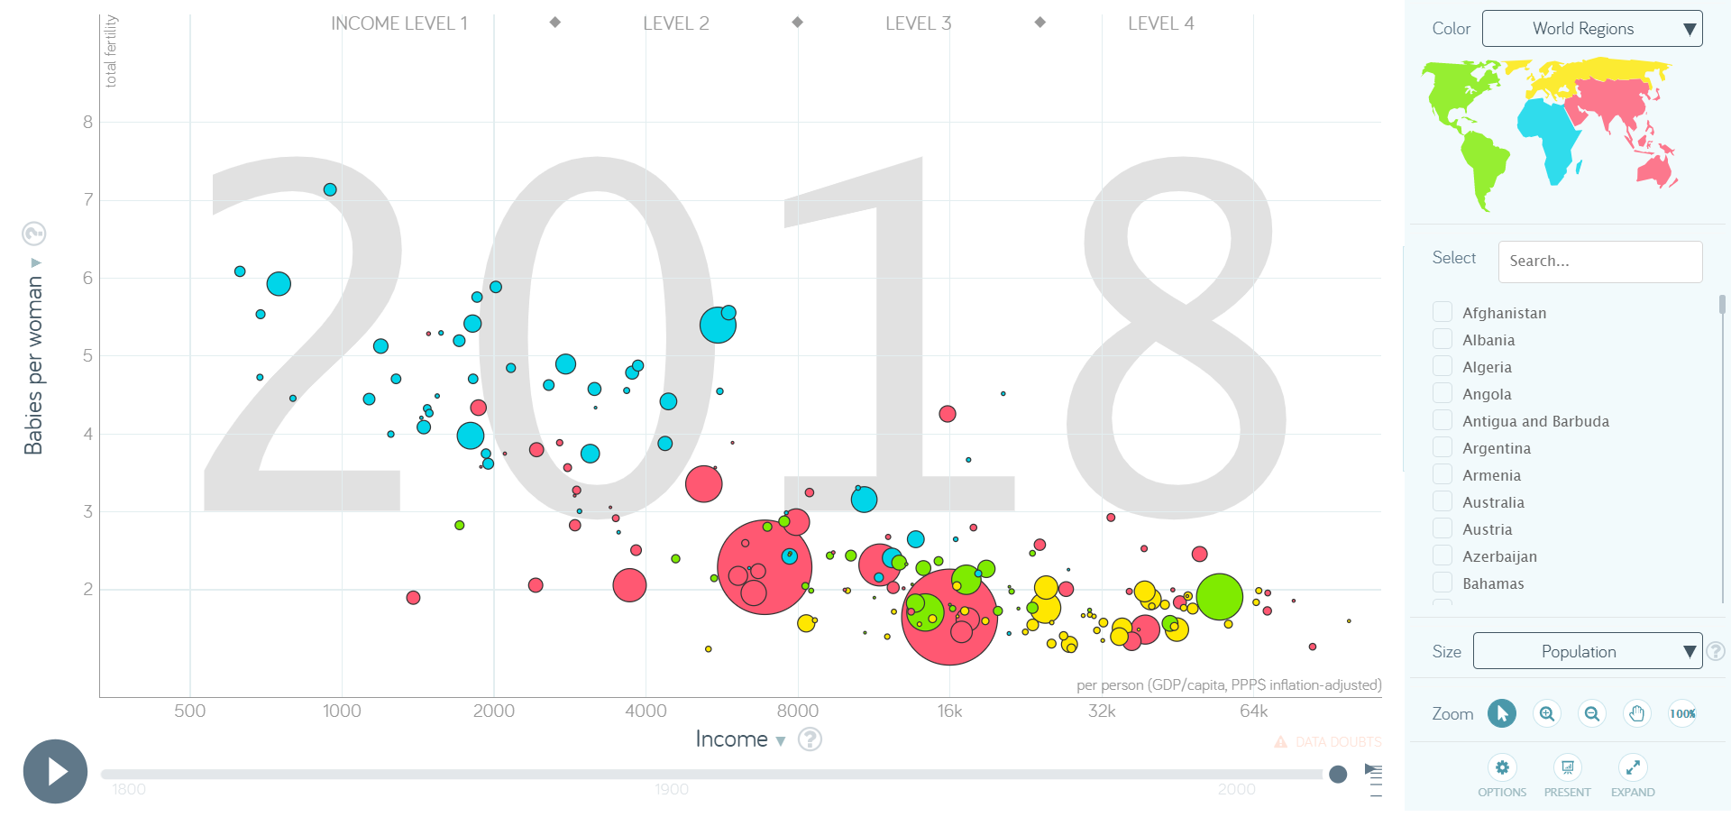
Expected insight I – Fertility and GDP per capita
Fertility rates refer to the average number of children a woman gives birth to during her lifetime, while GDP per capita stands for Gross Domestic Product per person, indicating the economic output per individual within a country.
A lower GDP per capita is typically associated with higher fertility rates, as economic constraints often lead to larger families.
This is confirmed by this chart illustrates GDP per Capita on the X-axis and fertility on the Y-axis, in which is clearly visible a negative correlation between these two variables.
It is a common occurrence that countries with higher GDP per capita are those that are more economically developed and economic development is associated with improved education, healthcare, and access to family planning, which can lead to reduced fertility.
This insight is quite significant as it underscores the role of economic development and social progress in influencing fertility trends

Slide 3
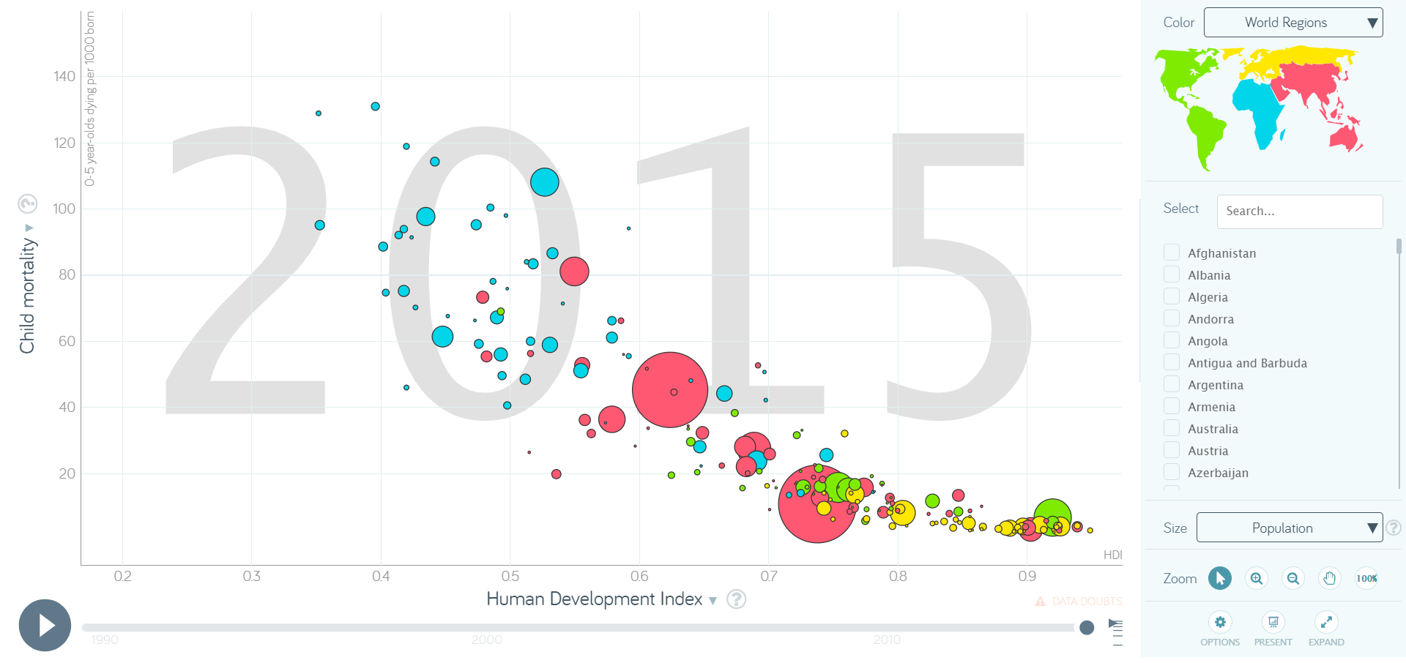
Expected insight II – HDI and CHILD mortality
HDI, or Human Development Index, is a composite measure that assesses a country's overall development based on factors like life expectancy, education, and per-capita income.
A very diffused assumption is that as a country's HDI improves, child mortality rates will significantly decrease, that is that better socio-economic conditions, healthcare access, and education will lead to improved child survival rates
The graph displays HDI on the X-axis and child mortality (0-5 years old dying per 1,000 born) on the Y-axis.
As depicted in the graph, the expected insight is confirmed: there is a significant negative correlation between HDI and child mortality.
Higher HDI is associated with lower child mortality rates, validating the common assumption that socio-economic development is linked to decreased child mortality rates.

Slide 4
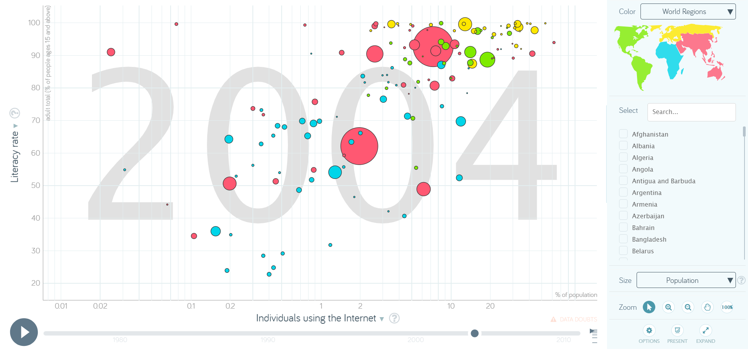
Expected insight III – Internet users and literacy rate
Literacy Rate is the percentage of people in a specific age group who can read and write with understanding.
Internet Users represents the number of individuals using the internet per 100 people.
The common assumption is that there should be a positive relationship between literacy rate and access to information and technology. Higher literacy rates might lead to a greater ability to use technology and access information.
The graph on the right clearly illustrates the expected insight. As literacy rates increase along the linear axis, there is a proportional increase in internet users (here in logarithmic scale). This correlation confirms our initial assumption. Of course there are some outliers, with high literacy rate and low individuals using the Internet (e.g. Myanmar country, the one with lowest individuals using the internet but very high literacy rate). This was due several reasons^{[I]} such as limited infrastructure, government regulations, and so on.
This insight could have significant implications for digital inclusion and educational policies. It may highlight the importance of literacy programs in promoting digital literacy and increasing internet access in underserved regions.
Myanmar
[I] Myanmar: guns vs. Google. The Seattle Times. Labbee, R. (2007, October 12).

Slide 5
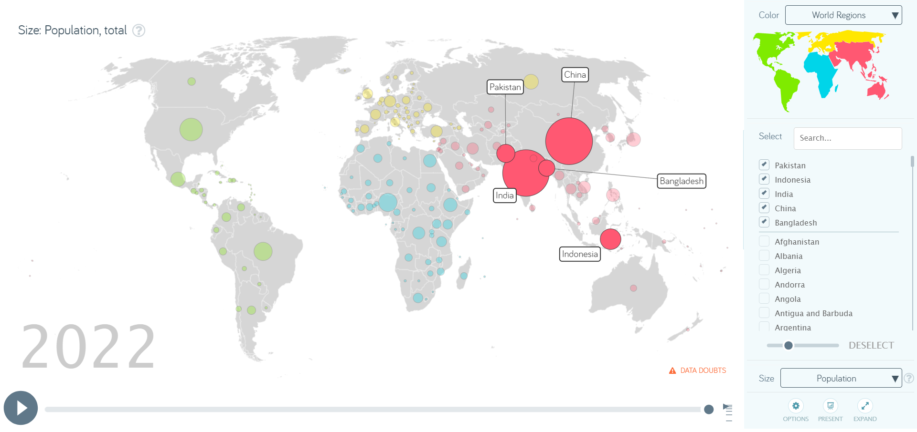
Unexpected insight I – global population distribution
In examining global population distribution, an unexpected insight emerges from the combined populations of five countries in Asia: in 2022, China, India, Indonesia, Bangladesh, and Pakistan collectively accounted for approximately 3.535 billion people.
As of 2022, the estimated global population is around 7.975 billion.
Surprisingly, these five countries together make up nearly 44.4% of the world's total population.
China and India alone account for over one-third of the world's population!
Moreover, the continent of Asia covers 29.4% of the Earth's land area and has a population of around 4.75 billion (as of 2022)^{[1I]}, accounting for about 60% of the world population.
We can conclude that the world's population distribution is characterized by significant concentration in a few nations, creating both opportunities and challenges that require global attention and cooperation
[1I] "Asia Population". World Population Prospects 2022. United Nations.

Slide 6
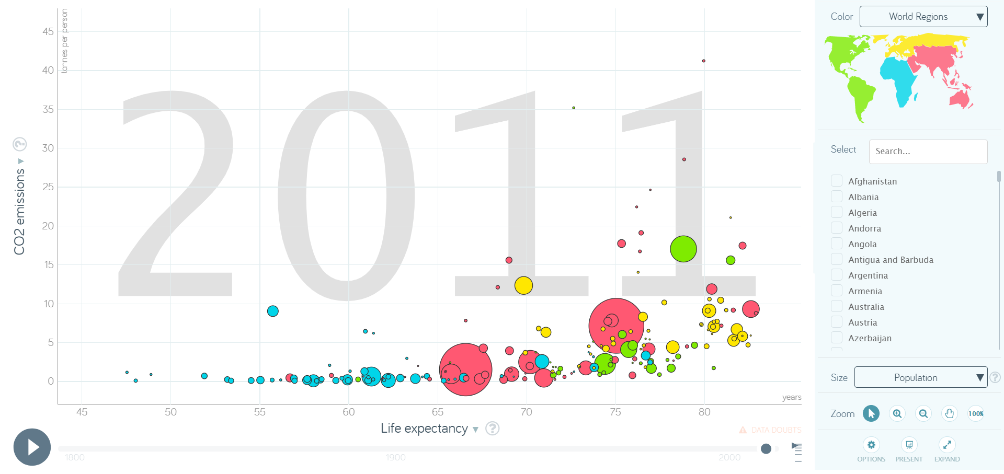
Unexpected insight II – co2 and life expectancy
The unexpected insight explores the relationship between life expectancy and CO2 emissions (tonnes per person).
Commonly, it is assumed that higher CO2 emissions are noxious to the environment and so, public health. Therefore, it’s expected that regions with higher CO2 emissions might have lower life expectancies due to the associated environmental and health risks.
Contrary to the common assumption, from the graphical analysis we get an unexpected insight: there is a positive correlation with CO2 emissions per capita. In other words, regions with greater life expectancy tend to have higher CO2 emissions.
However, that type of relationship simply implies that those two variables are correlated. It does not imply that higher CO2 emissions cause higher life expectancy
The observed correlation between CO2 emissions and life expectancy may suggests that as countries become more industrialized and increase energy consumption through fossil fuel burning, their economies grow, allowing for greater healthcare spending and, subsequently, higher life expectancy.
Additionally, we can also note that high CO2 emissions absolutely do not guarantee high life expectancy; some countries exhibit both high CO2 emissions and low life expectancy simultaneously.
Surely, further analysis and research are needed to get more interesting conclusions

Slide 7
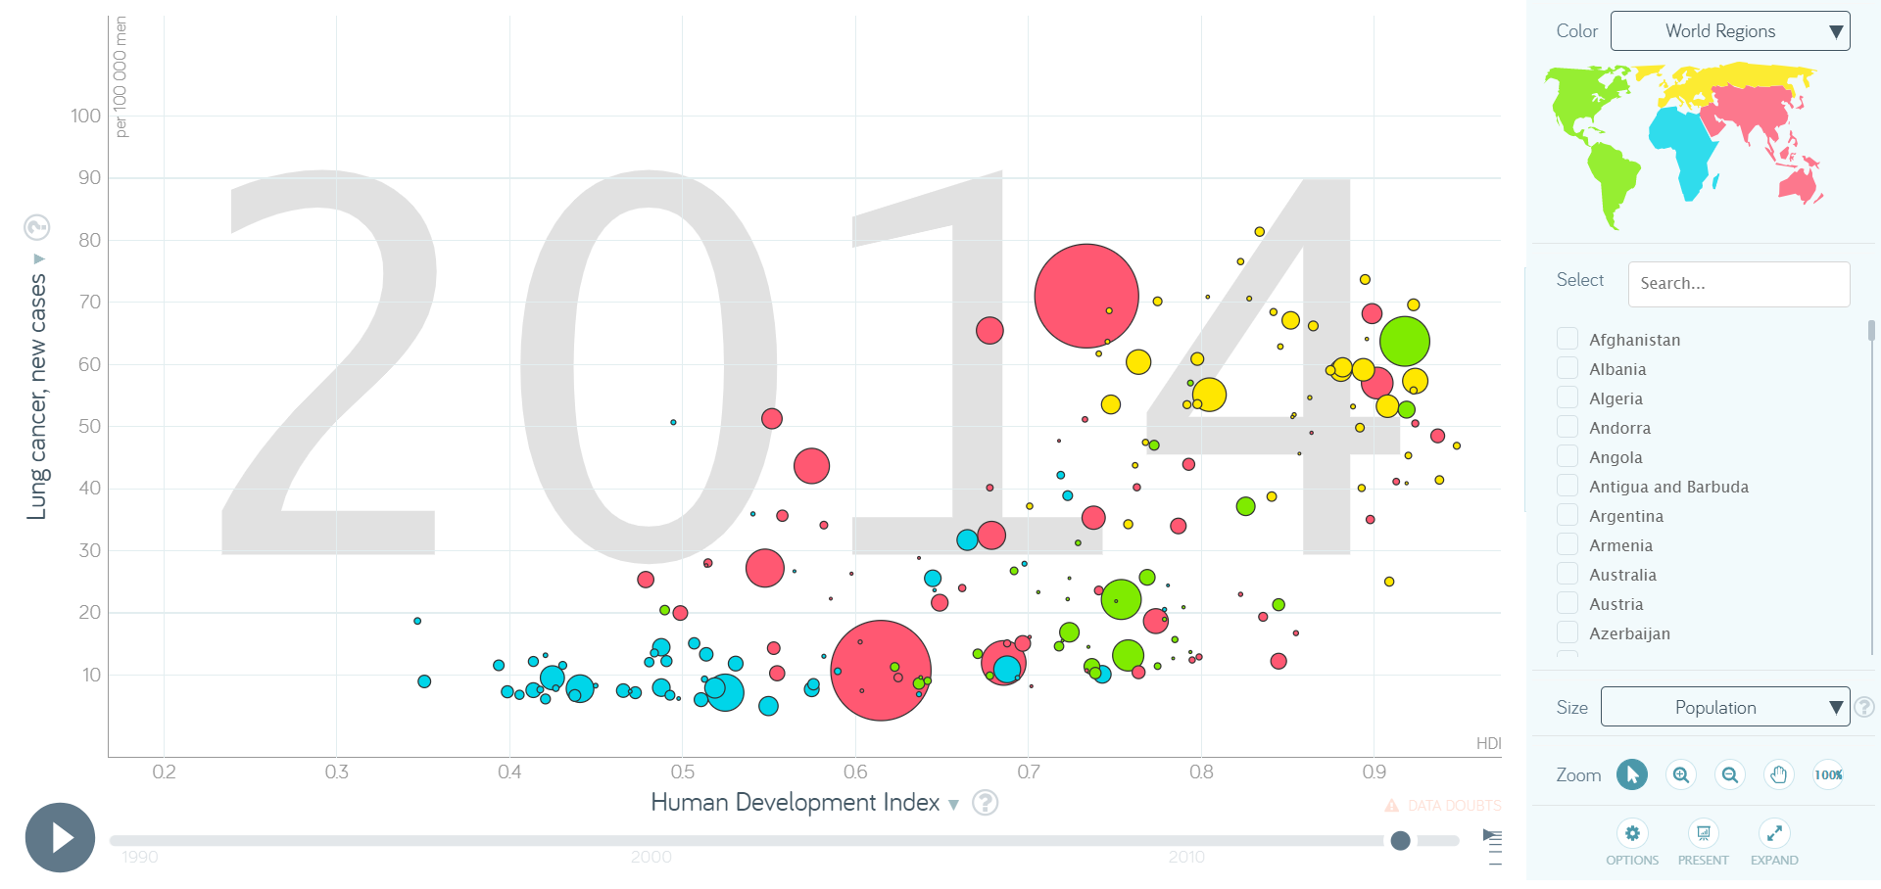
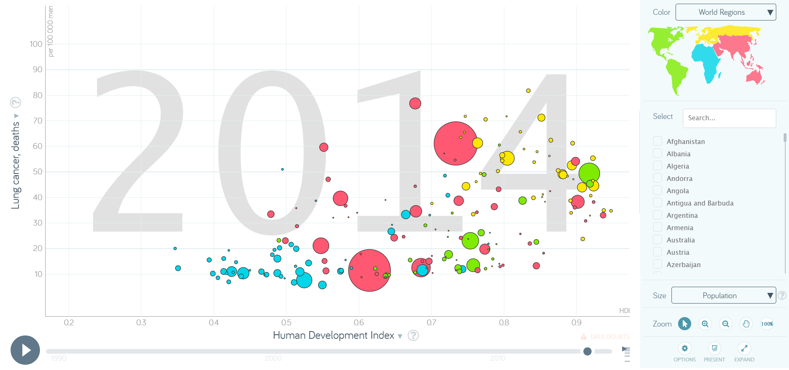
Unexpected Insight III – HDI and Lung Cancer
The relationship between a country's Human Development Index (HDI) and lung cancer death and cases per 100 000 men (2014) reveals some insights:
Initially, a positive correlation between HDI and lung cancer death and new case rates is observed. Higher HDI often coincides with higher lung cancer incidence and mortality. This correlation, in itself, is not unexpected.
What's unexpected is the remarkable consistency (and, in some cases, also illogical) in the difference between number of lung cancer cases and deaths in nations with varying HDI levels.

Slide 8
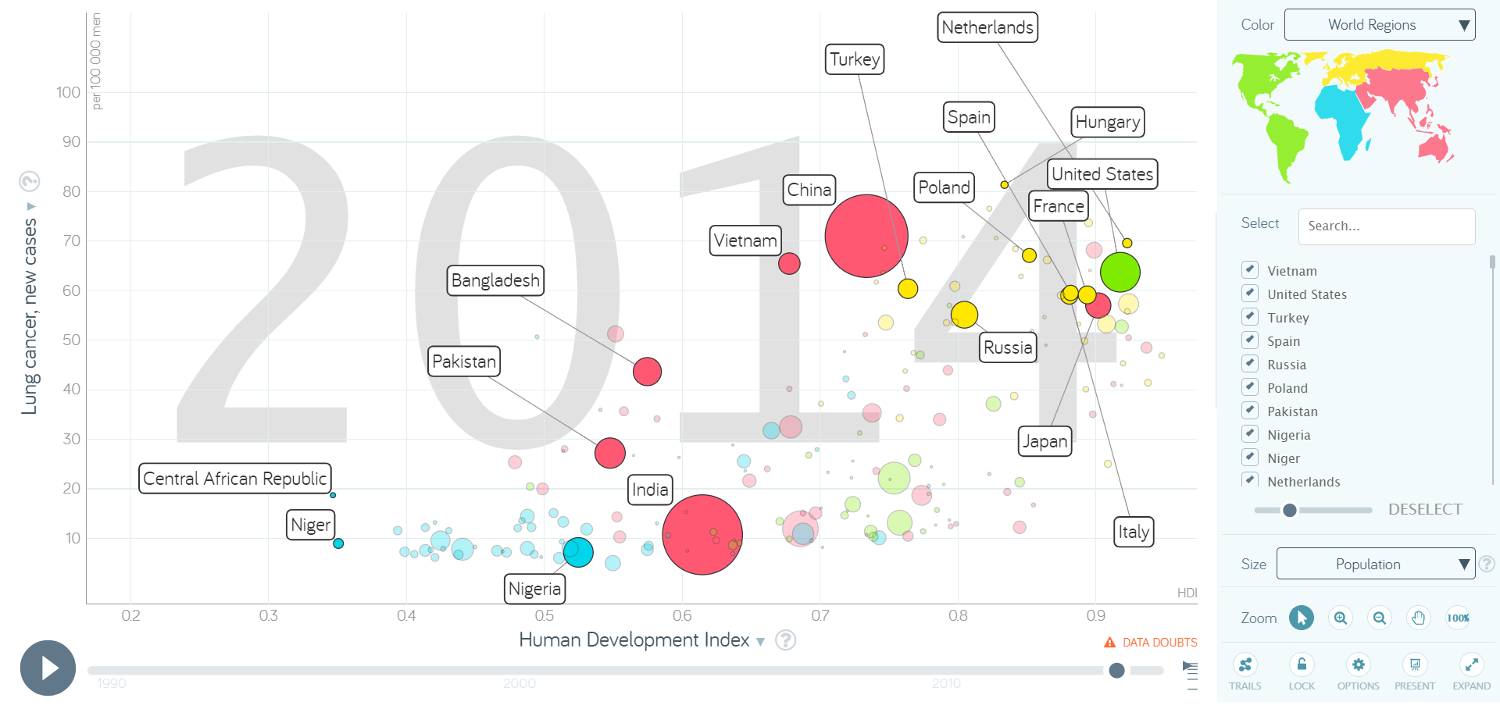
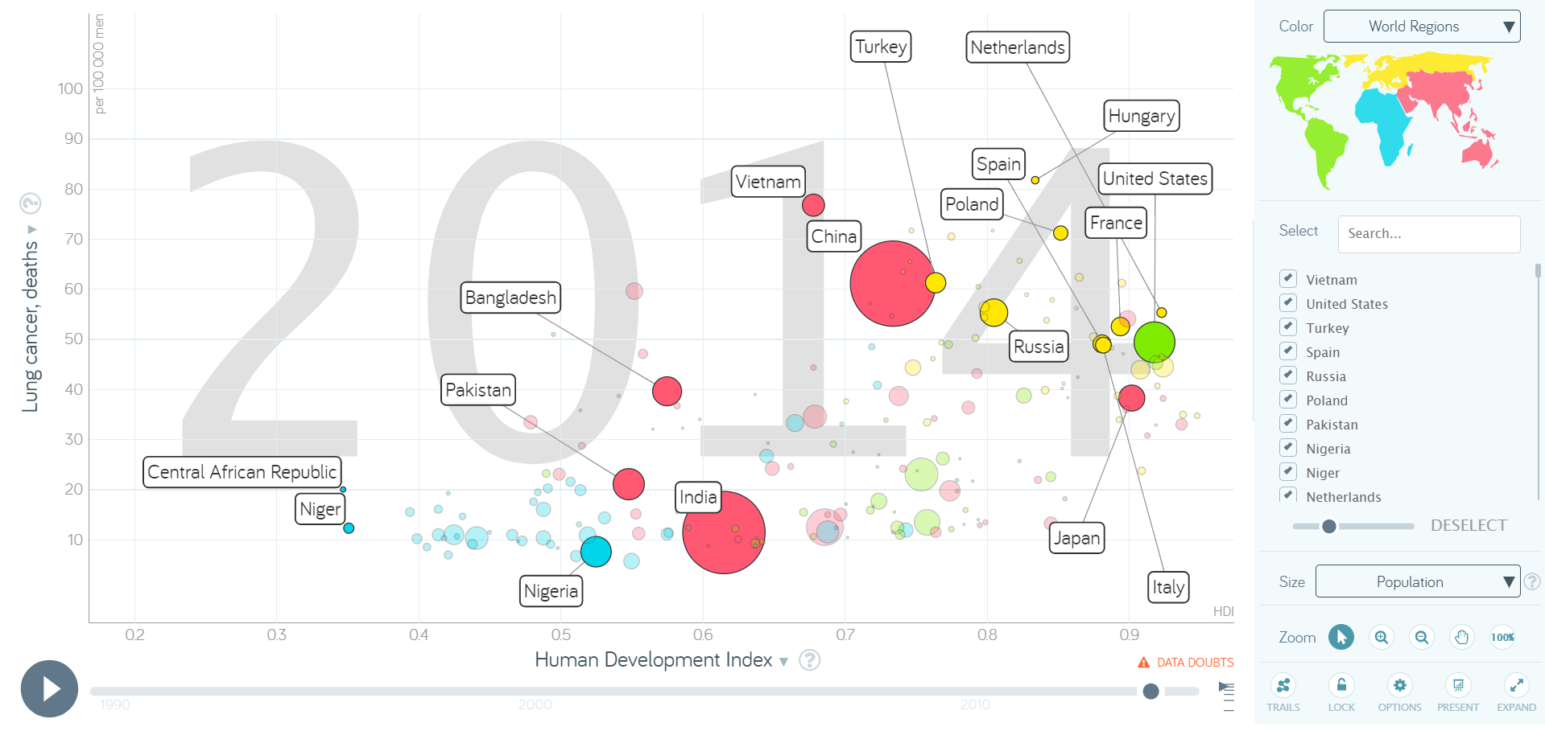
Unexpected Insight III – HDI and Lung Cancer
Some high-HDI nations (e.g., Netherlands, USA, Japan, Italy, Spain, China) exhibit a remarkable trend where the number of lung cancer deaths is lower than the number of new cases, highlighting successful prevention, early detection, and healthcare systems. However, a few high-HDI nations (e.g., Russia, Hungary, Poland) stand out with even more deaths than cases.
Many middle-HDI and low-HDI nations show a consistent pattern where the number of lung cancer cases is more or less the same as the number of deaths.
However, also these nations exhibit variations: some of them, as expected, such as Vietnam, experience an increase in the number of deaths, while others (e.g. Pakistan, Bangladesh, India) are showing a decrease in deaths, which could indicate improving healthcare practices.

Slide 9
Unexpected Insight III – HDI and Lung Cancer
The observations suggest that socio-economic development alone does not guarantee a significant reduction in lung cancer mortality.
The fact that some high-HDI nations still face high lung cancer incidence raises questions about the effectiveness of preventive efforts, while variations in low and middle-HDI nations emphasize the importance of targeted interventions, showing that improvement is possible even in less developed settings.

